Slide 1
Delta Lake
Notes:
As of 2/21/2020

Slide 2
Deep Dive into Delta Lake and UniForm
Author Name Date

Slide 3
Agenda
Intro to Delta Lake and core capabilities
Unpacking the Transaction Log Protocol
Data Layout Innovations
Uniform
Use cases
Roadmap

Slide 4
Delta Lake
Notes:
Speaker: Michelle

Slide 5
Delta Lake with UniForm is an open format that brings performance, interoperability, and ACID transactions to open data lakes.

Slide 6








Delta Lake Key Features
ACID Transactions
Protect your data with serializability, the strongest level of isolation.
Scalable Metadata
Handle petabyte-scale tables with billions of partitions and files at ease
Time Travel
Access/revert to earlier versions of data for audits, rollbacks, or reproduce
DML Operations
SQL, Scala/Java and Python APIs to merge, update and delete datasets
Unified Batch/Streaming
Exactly once semantics ingestion to backfill to interactive queries
Schema Evolution / Enforcement
Prevent bad data from causing data corruption
Audit History
Delta Lake log all change details providing a full audit trail
Open Source
Community driven, open standards, open protocol, open discussions
Notes:
Delta Lake gives you the tools you need to reliably store and work with data at scale on top of blob storage that you control, like S3 or ADLS
This includes key features like ACID transactions, the ability to time travel to previous versions, to ability to enforce or evolve schemas over time
These were all tremendous challenges in the olden days, back when wild Parquet files roamed the land
And the best part about it is: Delta Lake is completely open source and community driven.

Slide 7










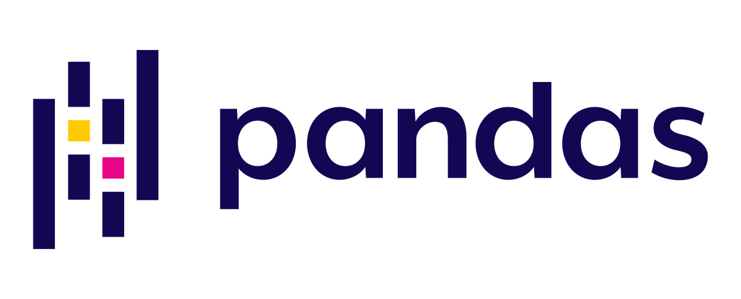





































Thriving ecosystem
Delta Flink
Delta Trino
Delta Rust / deltalake Python
Apache Druid
Google BigQuery
DuckDB
now i forget
=
=
Java Ecosystem
Java Ecosystem
pulsar
prestodb
pulsar
prestodb
beam
flink
beam
flink
Startree (pinot)
Startree (pinot)
hive
hive
Python Ecosystem
New or significantly updated
Python Ecosystem
azure synapse
delta- spark
azure synapse
delta- spark
dlt (spark-r)
emr
dlt (spark-r)
emr
pandas
aws- pandas-sdk
pandas
aws- pandas-sdk
Delta Kernel
deltalake
trino
trino
athena
athena
glue
glue
airbyte
duck DB
ray
dask
Delta Protocol
airbyte
duck DB
ray
dask
Delta Protocol
Iceberg
UniForm
arrow
Delta Sharing
polars
Rust Ecosystem
Snowflake
Kernel
data fusion
kafka
data fusion
ballista
ballista
Others
Apache Doris
Delta Sharing
Others
delta-rust
Hudi
Rust
R-Stats
Power BI
Delta Sharing
Rust
Ecosystem
Apache Impala
kafka
Power BI
Power BI
Rust
Fabric
Google BigQuery
Java
Excel
polars
arrow
R-Stats
Java
Excel
redshift
redshift
datahub
Golang
C++
datahub
Golang
C++
Notes:
We’ve also seen a thriving ecosystem of Delta connectors, with many being recently released
Thanks to UniForm, we’ve been able to extend support to the Iceberg and Hudi ecosystems

Slide 8
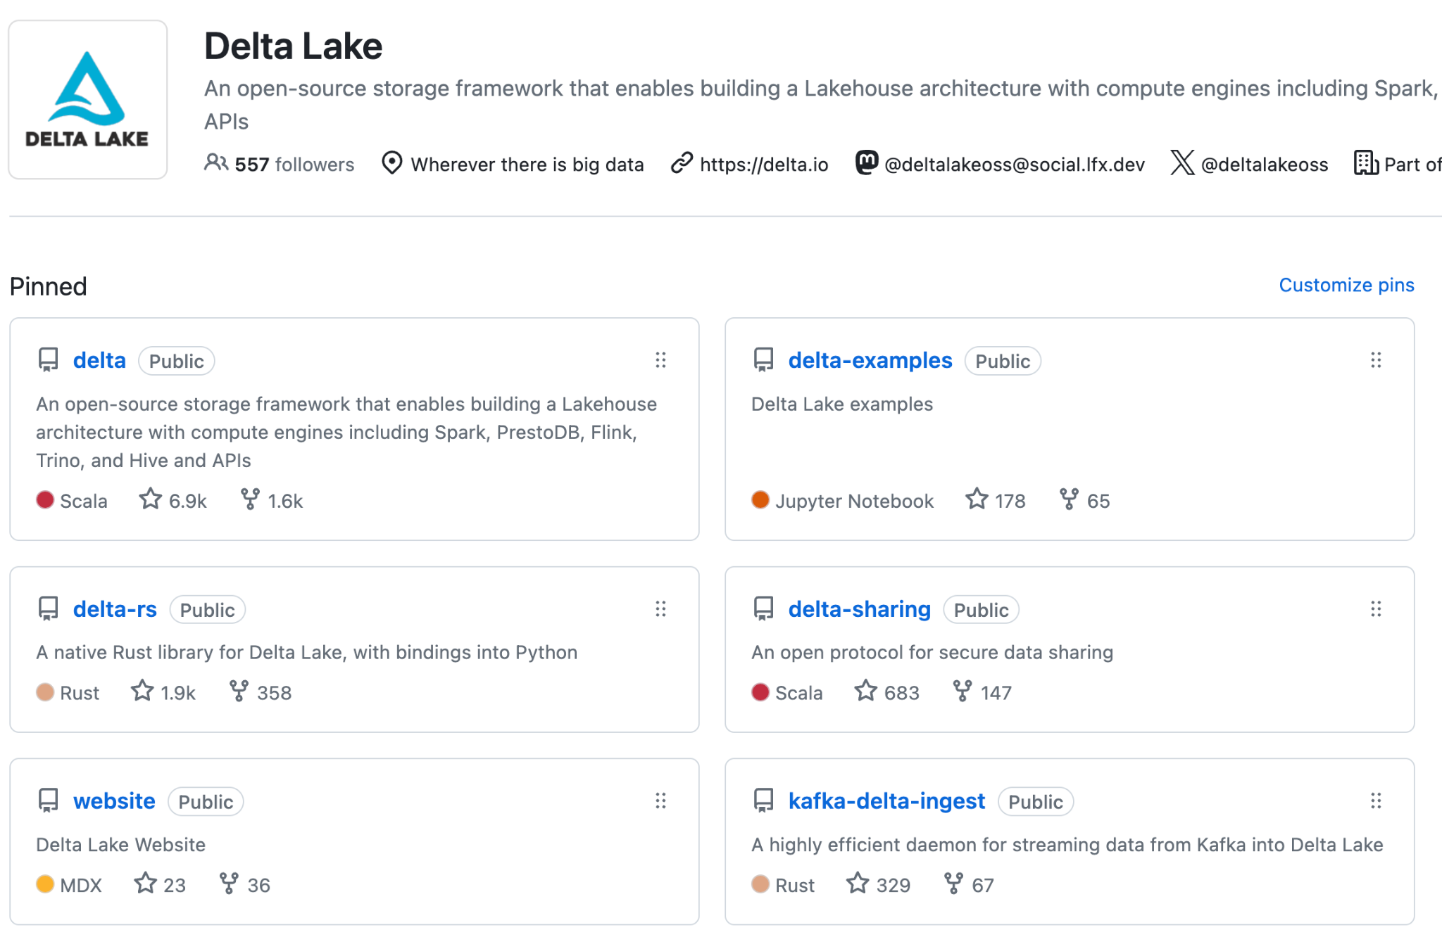
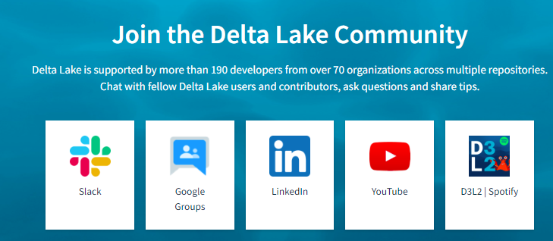
Community
11+ repos in the project
production and incubator projects
> 50 releases
Latest: Delta 3.2, Delta Rust 0.17
Very active community
~9K Github stars
~500 contributors
Slack: ~10K members
LinkedIn: ~50K members
YouTube: ~2.5K subscribers
Notes:
Delta has grown a lot since then, 11+ repos in the project.. Super fast release velocity : >50 releases. And very active and diverse community – around half of contributors are non-Databricks

Slide 9
Delta Lake:
The most adopted open lakehouse format
Scalable
Popular
Prevalent
Reliable
Innovative
Open
9+ exabytes
processed per day
1B+
Clusters per year
60%+
Fortune 500
Adoption
>10K+
Companies in production
80+
New features / year
>500
Contributors
2x yearly growth
Notes:
Both of these numbers have more than doubled year over year
Delta Lake is now used by over 60% of the Fortune 500, and across over 10,000 companies
This usage is thanks to rapid innovation powered by a large community of over 500 contributors

Slide 10


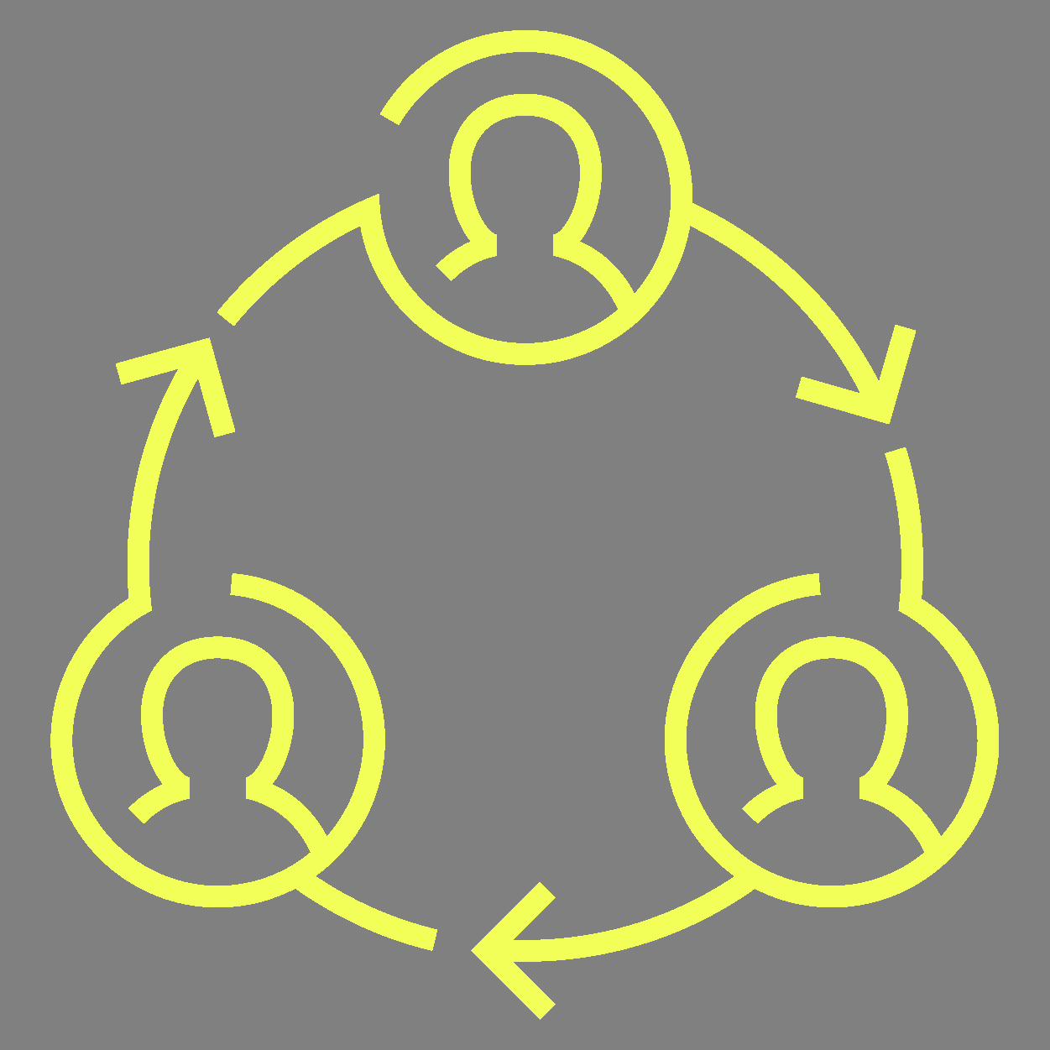

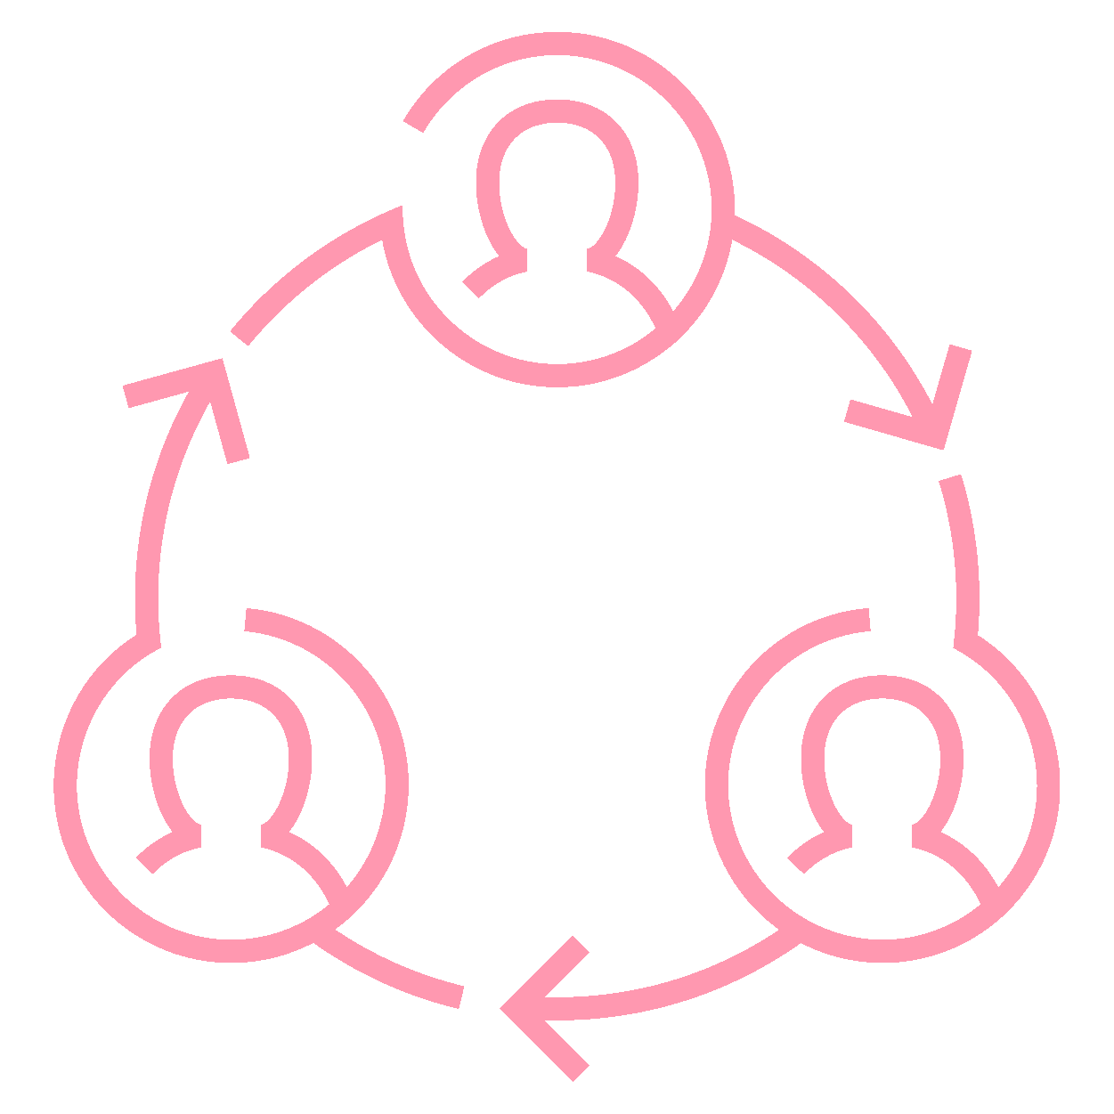

The biggest Delta Lake release yet
Delta 3.0
Delta 4.0
Deletion Vectors
Liquid clustering
Delta Kernel
Optimized Writes
VARIANT
Lightning fast semi-structured data
UniForm GA
Write once, read as all formats
Liquid GA
Easy migration from partitioned tables
Coordinated Commits
Cross cloud, cross engines
Table features
Incremental checkpoints
Log compactions
Row IDs
Spark Connect
Better stability, upgradability
Collations
Flexible sort and comparison
Identity columns
Pain-free primary and foreign keys
Type widening
Data types expand with your data
Table cloning
MERGE improvements
CDF
Auto-
compaction
Notes:
Delta 4.0 is our biggest Delta release yet - it’s jam packed with next generation capabilities to help customers meet the growing volumes and varieties of data
We don’t have nearly the time to talk about all of the planned capabilities
But today, we’d to deep-dive on a few of the most exciting capabilities

Slide 11
Unpacking the transaction log
Notes:
Speaker: Joe
In this talk – we are going to cover all of these and more – starting with unpacking the transaction log, and then diving into some of the more recent innovations.

Slide 12
Delta Lake on Disk
/mytable/ _delta_log/ 00010.checkpoint.parquet 00011.json 00012.json _last_checkpoint _change_data/ cdc-file1.snappy.parquet date=2024-06-14/ file-1.snappy.parquet deletion_vector1.bin

Slide 13
Delta Lake on Disk
/mytable/ _delta_log/ 00010.checkpoint.parquet 00011.json 00012.json _last_checkpoint _change_data/ cdc-file1.snappy.parquet date=2024-06-14/ file-1.snappy.parquet deletion_vector1.bin
Transaction Log
Commits & Checkpoints
Checkpoint pointer
(Optional) Change Data
(Optional) Partition Directories
Data
(Optional) Deletion Vectors

Slide 14
Table = result of a set of actions
Metadata – name, schema, partitioning, etc
Add File – adds a file (with optional statistics)
Remove File – removes a file
Transaction Identifier – records an idempotent transaction id
Protocol Evolution – upgrades the version of the txn protocol
Commit Provenance – additional information about what higher-level operations was being performed as well as who executed it
Result: Current Metadata, List of Files, List of Txns, Version

Slide 15
Example of an addFile action
The add action is used to modify the data in the table by adding individual files respectively.
{ "add": { "path": "date=2017-12-10/part-000...c000.gz.parquet", "partitionValues": {"date": "2017-12-10"}, "size": 841454, "modificationTime": 1512909768000, "dataChange": true, "baseRowId": 4071, "defaultRowCommitVersion": 41, "stats": "{\"numRecords\":1,\"minValues\":{\"val..." } }
Path, partitionValues, size, modificationTime and dataChange are required fields. Other fields like stats, tags, and clusteringProvider are optional.

Slide 16
ACID properties
Notes:
Speaker: Joe
In this talk – we are going to cover all of these and more – starting with unpacking the transaction log, and then diving into some of the more recent innovations.

Slide 17
Implementing Atomicity
Changes to the table are stored as ordered, atomic units called commits
Add 1.parquet
Add 2.parquet
000000.json
000001.json
Remove 1.parquet
Remove 2.parquet
Add 3.parquet
Notes:
https://www.databricks.com/glossary/acid-transactions

Slide 18
Ensuring Serializability
Need to agree on the order of changes, even when there are multiple writers.
000000.json
000001.json
000002.json
User 1
User 2

Slide 19
Solving Conflicts Optimistically
Read: Schema
Read: Schema
Record Start Version
Record reads/writes
Attempt commit
If someone else wins, check if anything you read has changed
Try again
Write: Append
Write: Append
User 1
000000.json
000001.json
000002.json
User 2

Slide 20
Transactions and reliability are great, but what about performance?

Slide 21



Handling Massive Metadata
Large tables can have millions of files. Delta Lake can use a distributed engine for scaling
Add 1.parquet
Add 2.parquet
Checkpoint
Remove 1.parquet
Remove 2.parquet
Add 3.parquet

Slide 22
Updating Delta Lake’s State
listFrom version 0
000000.json
000001.json
000002.json
000003.json
000004.json
000005.json
000005.json
000006.json
000007.json
Checkpoint
Cache version 7

Slide 23
Updating Delta Lake’s State
000000.json
...
000007.json
000008.json
000009.json
0000010.json
0000010.checkpoint.parquet
0000011.json
0000012.json
listFrom version 7
Checkpoint
Read the checkpoint
Cache version 12

Slide 24
Finding the latest metadata
The Delta transaction log can contain many (e.g. 10,000+) commits and this can take a long time to list
_last_checkpoint provides a pointer to near the end of the log
listFrom storage API provides the ability to list only from the last known checkpoint
/mytable/ _delta_log/ 0000.json 0001.json 0002.json … 0100.checkpoint.parquet 0101.json … 0200.checkpoint.parquet 0201.json _last_checkpoint …

Slide 25
Time Travel
Notes:
Speaker: Joe
In this talk – we are going to cover all of these and more – starting with unpacking the transaction log, and then diving into some of the more recent innovations.

Slide 26
Time Traveling by version
SELECT * FROM my_table VERSION AS OF 500;
SELECT * FROM my_table@v500
spark.read.option("versionAsOf", 500).load("/some/path")
spark.read.load("/some/path@v500")
deltaLog.getSnapshotAt(500)
Notes:
There are 509 contributors to the delta project ish when i wrote this

Slide 27
Time Traveling by timestamp
SELECT * FROM my_table TIMESTAMP AS OF '2019-10-16';
SELECT * FROM my_table@20191016000000000 -- yyyyMMddHHmmssSSS
spark.read.option("timestampAsOf", "2019-10-16").load("/some/path")
spark.read.load("/some/path@20191016000000000")
deltaLog.getSnapshotAt(500)
Notes:
10/16/2019 is when Delta was donated to the linux foundation

Slide 28
Time Traveling by timestamp
Commit timestamps come from storage system modification timestamps
001070.json 2019-10-16
001071.json 2021-05-24
001072.json 2022-07-20
001073.json 2022-06-30
Notes:
Clock skew from distributed systems that contribute to this out of order system timestamps
Delta Lake 1.0 was released May 24th 2021
Delta Lake 2.0 was released July 20th 2022
Nothing of significance for June 30th, I just need a date to fit my track

Slide 29
Time Traveling by timestamp
Timestamps can be out of order. We adjust by adding 1 millisecond to the previous commit’s timestamp
001070.json 2019-06-19 2019-06-19
001071.json 2021-05-24 2021-05-24
001072.json 2022-07-20 2022-07-20
001073.json 2022-06-30 2022-07-20 00:00:00.01

Slide 30
Time Traveling by timestamp
Price is right rules - pick the closest commit timestamp that doesn’t exceed the users timestamp
001070.json 2019-06-19
001071.json 2021-05-24
001072.json 2022-07-20
001073.json 2022-07-20 00:00:00.01
2022-04-13
Notes:
April 13ths 2022 is when restore was added to Delta Lake

Slide 31
The Single Source of Truth!

Slide 32
Information required to plan a query
Information
Parquet Source
Delta Lake Source
Schema
Partition Columns and values
Files to read
File Statistics
Protocol (Delta Only)
HMS or inferred from file footer
HMS or inferred
FileSystem listing
NA
NA
Transaction Log
Transaction Log
Transaction Log
Transaction Log
Transaction Log

Slide 33
Getting the schema of a Delta Lake table
Read the transaction log!
Collect all the metadata actions for your table
Merge the schema strings together
Time Travel allows you to go back before meta changes!
{
"metaData":{
"id":"af23c9d7-fff1-4a5a-a2c8-55c59bd782aa",
"format":{"provider":"parquet","options":{}},
"schemaString":"...",
"partitionColumns":[],
"configuration":{
"appendOnly": "true"
}
}
}

Slide 34
Getting the partition columns
Read the transaction log!
Collect all the metadata actions for your table
Collect list of partition columns
Scales to millions of partitions
{
"metaData":{
"id":"af23c9d7-fff1-4a5a-a2c8-55c59bd782aa",
"format":{"provider":"parquet","options":{}},
"schemaString":"...",
"partitionColumns":[],
"configuration":{
"appendOnly": "true"
}
}
}

Slide 35
Getting the list of files to read
Read the transaction log!
Collect all the add file actions
Apply partition and data filters
Collect list of paths
Scales to millions of files
{
"add": {
"path": "date=2017-12-10/part-000...c000.gz.parquet",
"partitionValues": {"date": "2017-12-10"},
"size": 841454,
"modificationTime": 1512909768000,
"dataChange": true,
"stats": "{\"numRecords\":1,\"minValues\":{\"val..."
}
}

Slide 36
Additional Features

Slide 37
Generated Columns
A generated column is a special column that’s defined with a SQL Expression
CREATE TABLE events(
eventId BIGINT,
data STRING,
eventType STRING,
eventTime TIMESTAMP,
eventDate date GENERATED ALWAYS AS (CAST(eventTime AS DATE))
)
PARTITIONED BY (eventType, eventDate)

Slide 38
Generated Columns
Querying a generated column will apply partition pushdown if you use the generated column, or the column it was generated from
SELECT * From events WHERE eventTime >= "2020-10-01 00:00:00" <= "2020-10-01 12:00:00"
For the above query, we will only read the date 2020-10-01 even though the partition filter is not specified

Slide 39
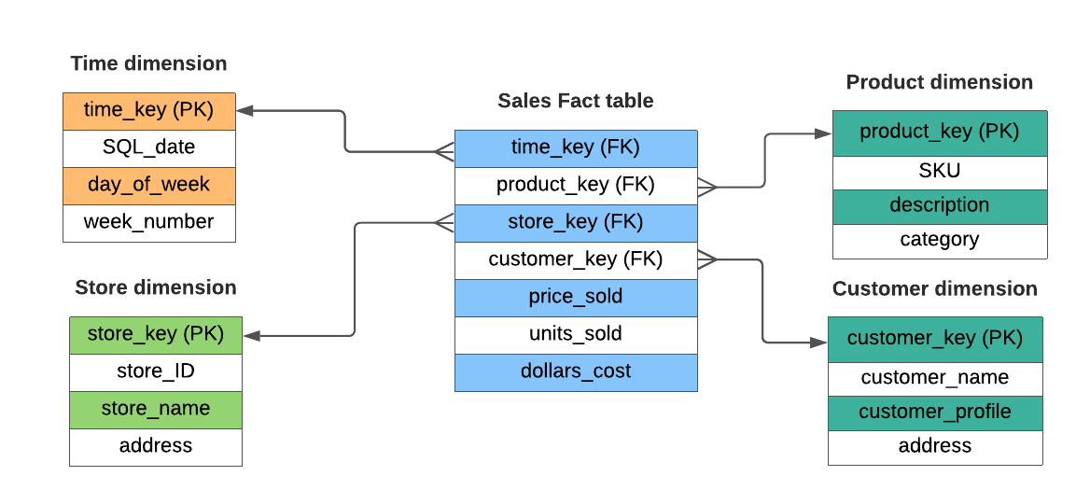
Support for Identity Columns, Primary + Foreign Key Constraints
IDENTITY COLUMNS
PRIMARY + FOREIGN KEY DECLARATIONS
Define IDENTITY column on a table
Delta can automatically generate unique integer values when new rows are added to the table with IDENTITY columns
Users can also explicitly insert values for the IDENTITY columns
Declare unenforced Primary and Foreign keys with ALTER TABLE
Visible in INFORMATION_SCHEMA and DESCRIBE TABLE
Allow end users to understand relationships between tables
GOAL: Enable data quality and easy table relationship discovery for tools and users that are not familiar with the data model.

Slide 40
Identity Columns
Delta Lake Identity Support
Always option doesn’t allow column override
By Default option does allow column override but *doesn’t enforce duplicates*
Start With option allows you to start anywhere
Increment option allows you to set the increment
CREATE TABLE IF NOT EXISTS dim_loan
(
Loan_sk BIGINT GENERATED ALWAYS AS IDENTITY,
Loan_id BIGINT,
……..
)
USING DELTA
LOCATION 'abfs://<container>@<storage account>/'
Options
ALWAYS | BY DEFAULT
START WITH start
INCREMENT BY step
1
Notes:
https://docs.microsoft.com/en-us/azure/databricks/spark/latest/spark-sql/language-manual/sql-ref-syntax-ddl-create-table-using

Slide 41
Speeding up queries

Slide 42
Speeding up queries
Reading only the necessary rows for a query = Efficient query processing
How does the transaction log help with that?

Slide 43
Partitioned Tables : Partition Pruning
/mytable/ part=1/part_00001.parquet part=1/part_00002.parquet part=2/part_00001.parquet part=2/part_00002.parquet
select * from mytable where part = 2

Slide 44
Data Skipping
Simple, well-known I/O pruning technique
Track file-level stats like min & max
Leverage them to avoid scanning irrelevant files
file_name | col_min | col_max
1.parquet | 6 | 8
2.parquet | 3 | 10
3.parquet | 1 | 4
SELECT input_file_name() as “file_name”,
min(col) AS “col_min”,
max(col) AS “col_max”
FROM table
GROUP BY input_file_name()

Slide 45
Data Skipping
SELECT file_name FROM index
WHERE col_min < 5 AND col_max >= 5
file_name | col_min | col_max
1.parquet | 6 | 8
2.parquet | 3 | 10
3.parquet | 1 | 4

Slide 46
Data Layout Challenges

Slide 47
Hive-style partitioning
Working example: A table partitioned by customer ID and date
 | 2023-02-05 | 2023-02-06 | 2023-02-07 | 2023-02-08
Customer A
Customer B
The Whale
Tiny 1
Tiny 2
Customer C
Target file size
Each partition contains files for one customer+date pair
e.g. (The Whale, 2023-02-07)
Number and size of files is different for each partition
Some partitions may not contain any files (yet)
Notes:
In order to understand why liquid will be such a big deal, first we need to understand what’s wrong with partitioning today.
Data skew

Slide 48
Hive-style partitioning
A table can be over- or under-partitioned — or both at the same time!
 | 2023-02-05 | 2023-02-06 | 2023-02-07 | 2023-02-08
Customer A
Customer B
The Whale
Tiny 1
Tiny 2
Customer C
Target file size
Costly overread to query just one hour for a big customer
Costly small-file explosion to query a small customer
Prefer to partition by week? By hour? Have to rewrite the whole table
Notes:
Small files
Not the right granularity
Cannot re-partition

Slide 49
Hive-style partitioning
Most ingest is small, causing small-file explosion
 | 2023-02-05 | 2023-02-06 | 2023-02-07 | 2023-02-08
Customer A
Customer B
The Whale
Tiny 1
Tiny 2
Customer C
Target file size
Ingest new data every hour?
24 files per customer/day.
Ingest small data for many customers at once? One tiny file per customer.
Frequent table maintenance needed to control file counts
Notes:
Small files, need additional maintenance jobs to manage data

Slide 50
OPTIMIZE your table
{ "remove": { "path": "part-00001-9…..snappy.parquet", "deletionTimestamp": 1512909768000, "dataChange": false } } { "add": { "path": "part-0000…..gz.parquet", "size": 256841454, "modificationTime": 1512909768000, "dataChange": false, "stats": "{ \"numRecords\":123456789,\"minValues\":{\"val..." } }
OPTIMIZE my_table

Slide 51
Z-Ordering
optimize my_table zorder by col
Old Layout
New Layout
file_name | col_min | col_max
1.parquet | 6 | 8
2.parquet | 3 | 10
3.parquet | 1 | 4
file_name | col_min | col_max
1.parquet | 1 | 3
2.parquet | 4 | 7
3.parquet | 8 | 10

Slide 52
Z-Ordering
select * from table where col = 7
Old Layout
New Layout
file_name | col_min | col_max
1.parquet | 6 | 8
2.parquet | 3 | 10
3.parquet | 1 | 4
file_name | col_min | col_max
1.parquet | 1 | 3
2.parquet | 4 | 7
3.parquet | 8 | 10

Slide 53

Challenges with Z-order
Due to the span of the Z-Curve, some files will have min/max range equal to the full range, and data skipping can’t skip these files.
Any new data ingested after the OPTIMIZE ZORDER BY run is not automatically clustered, and the user needs to rerun the command to cluster the new data.
OPTIMIZE ZORDER BY reclusters already well-clustered data, resulting in high write amplification.
ZORDER BY columns are not persisted and the user is required to remember the previous ZORDER BY columns, often causing user errors if different columns are used
Z-Curve

Slide 54
Data Layout Innovations

Slide 55
Liquid Clustering - No more partitions
Fast
Faster writes and similar reads vs. well-tuned partitioned tables
Self-tuning
Avoids over- and under-partitioning
Incremental
Automatic partial clustering of new data
Skew-resistant
Produces consistent file sizes and low write amplification
Flexible
Want to change the clustering columns? No problem!
Better concurrency
Notes:
Simplify data layout decision from day one and reduce maintenance burden over time
No knobs needed for
Determine optimal file size
Determine if a column can be used as partition column
Determine the order of partition columns when creating tables
Determine the optimal frequency to run OPTIMIZE

Slide 56
Liquid clustering Usage Walkthrough
Create a new Delta table with liquid clustering CREATE [EXTERNAL] TABLE tbl (id INT, name STRING) CLUSTER BY(id)
Change Liquid Clustering keys on existing clustered table:
ALTER TABLE tbl CLUSTER BY (name);
Clustering data in a Delta table with liquid clustering:
OPTIMIZE tbl;
What you don’t need to worry about:
Optimal file sizes
Whether a column can be used as a clustering key
Order of clustering keys
Notes:
Talking points
This is tentative, we want your feedback

Slide 57
Liquid clustering in action
Efficiently balance clustering vs. file size
 | 2023-02-05 | 2023-02-06 | 2023-02-07 | 2023-02-08
Customer A
Customer B
The Whale
Tiny 1
Tiny 2
Customer C
Target file size

Slide 58
Liquid clustering in action
Efficiently balance clustering vs. file size
 | 2023-02-05 | 2023-02-06 | 2023-02-07 | 2023-02-08
Customer A
Customer B
The Whale
Tiny 1
Tiny 2
Customer C
Target file size
One file covers several dates for a single small customer

Slide 59
Liquid clustering in action
Efficiently balance clustering vs. file size
 | 2023-02-05 | 2023-02-06 | 2023-02-07 | 2023-02-08
Customer A
Customer B
The Whale
Tiny 1
Tiny 2
Customer C
Target file size
One file covers several dates for a single small customer

Slide 60
Liquid clustering in action
Efficiently balance clustering vs. file size
 | 2023-02-05 | 2023-02-06 | 2023-02-07 | 2023-02-08
Customer A
Customer B
The Whale
Tiny 1
Tiny 2
Customer C
Target file size
One file covers several dates for a single small customer
One file covers several customers for a single date

Slide 61
Liquid clustering in action
Efficiently balance clustering vs. file size
 | 2023-02-05 | 2023-02-06 | 2023-02-07 | 2023-02-08
Customer A
Customer B
The Whale
Tiny 1
Tiny 2
Customer C
Target file size
One file covers several dates for a single small customer
One file covers several customers for a single date

Slide 62
Liquid clustering in action
Efficiently balance clustering vs. file size
 | 2023-02-05 | 2023-02-06 | 2023-02-07 | 2023-02-08
Customer A
Customer B
The Whale
Tiny 1
Tiny 2
Customer C
Target file size
One file covers several dates for a single small customer
One file covers several customers for a single date
One file covers several dates for several tiny customers

Slide 63
Liquid clustering in action
Efficiently balance clustering vs. file size
 | 2023-02-05 | 2023-02-06 | 2023-02-07 | 2023-02-08
Customer A
Customer B
The Whale
Tiny 1
Tiny 2
Customer C
Target file size
One file covers several dates for a single small customer
One file covers several customers for a single date
One file covers several dates for several tiny customers

Slide 64
Liquid clustering in action
But wait, there’s more!
 | 2023-02-05 | 2023-02-06 | 2023-02-07 | 2023-02-08
Customer A
Customer B
The Whale
Tiny 1
Tiny 2
Customer C
Target file size

Slide 65
Liquid clustering in action
Automatically cluster heavy partitions more finely
 | 2023-02-05 | 2023-02-06 | 2023-02-07 | 2023-02-08
Customer A
Customer B
The Whale
Tiny 1
Tiny 2
Customer C
Target file size
Subdivide a heavy partition by hours within a day

Slide 66
Liquid clustering in action
Automatically cluster heavy partitions more finely
 | 2023-02-05 | 2023-02-06 | 2023-02-07 | 2023-02-08
Customer A
Customer B
The Whale
Tiny 1
Tiny 2
Customer C
Target file size
Subdivide a heavy partition by hours within a day

Slide 67
Liquid clustering in action
But wait, there’s more!
 | 2023-02-05 | 2023-02-06 | 2023-02-07 | 2023-02-08
Customer A
Customer B
The Whale
Tiny 1
Tiny 2
Customer C
Target file size

Slide 68
Liquid clustering in action
Efficient ingest with lazy/partial clustering
 | 2023-02-05 | 2023-02-06 | 2023-02-07 | 2023-02-08
Customer A
Customer B
The Whale
Tiny 1
Tiny 2
Customer C
Target file size
At first, one file per ingest, each covering all customers

Slide 69
Liquid clustering in action
Efficient ingest with lazy/partial clustering
 | 2023-02-05 | 2023-02-06 | 2023-02-07 | 2023-02-08
Customer A
Customer B
The Whale
Tiny 1
Tiny 2
Customer C
Target file size
At first, one file per ingest, each covering all customers

Slide 70
Liquid clustering in action
Efficient ingest with lazy/partial clustering
 | 2023-02-05 | 2023-02-06 | 2023-02-07 | 2023-02-08
Customer A
Customer B
The Whale
Tiny 1
Tiny 2
Customer C
Target file size
As data accumulates, start splitting out customers

Slide 71
Liquid clustering in action
Efficient ingest with lazy/partial clustering
 | 2023-02-05 | 2023-02-06 | 2023-02-07 | 2023-02-08
Customer A
Customer B
The Whale
Tiny 1
Tiny 2
Customer C
Target file size
As data accumulates, start splitting out customers

Slide 72
Liquid clustering in action
Efficient ingest with lazy/partial clustering
 | 2023-02-05 | 2023-02-06 | 2023-02-07 | 2023-02-08
Customer A
Customer B
The Whale
Tiny 1
Tiny 2
Customer C
Target file size
Later, table maintenance combines the last small files

Slide 73
Liquid clustering in action
Efficient ingest with lazy/partial clustering
 | 2023-02-05 | 2023-02-06 | 2023-02-07 | 2023-02-08
Customer A
Customer B
The Whale
Tiny 1
Tiny 2
Customer C
Target file size
Later, table maintenance combines the last small files

Slide 74
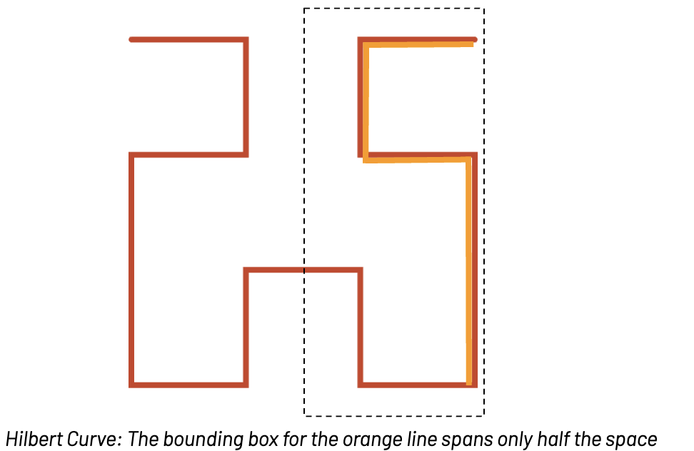
Liquid under-the-hood
Better data-skipping due to hilbert curves

Slide 75
Liquid clustering is incremental
OPTIMIZE my_table
Z-Cube 1
A Z-Cube

Slide 76
Liquid clustering is incremental
OPTIMIZE my_table
Z-Cube 1
Z-Cube 1
A Z-Cube
New data
Z-Cube 1
Incorporate new data into existing Z-cubes if cubes < 150 GB

Slide 77
Tables can have many ZCubes
Z-Cube 1
When we get to 150gb, we start a new ZCube to minimize write amplification on Zorder
When data is removed from ZCube, possibly due to DML, once the ZCube reaches a threshold its eligible for more data to be added to it
Z-Cube 2
Z-Cube 3
Notes:
Example - partition with 10 zcubes, using zorder on (col1,col2). Select * from table where col1 = 1 It will have at least 10 files to read. If the partition only had 1 zcube, it would have at least 1 file to read.
Example - 10gb per partition vs 10tb per partition, how many zcubes in each partition?

Slide 78

POP QUIZ
Notes:
UniForm is incredibly easy to use. Once enabled, UniForm:
Automatically generates Iceberg or Hudi metadata alongside Delta Lake
The Parquet files remain the same – there is no duplication of data
Metadata is co-located with the data – the metadata for all enabled formats is accessible to any engine in your own storage bucket

Slide 79

POP QUIZ
Notes:
UniForm is incredibly easy to use. Once enabled, UniForm:
Automatically generates Iceberg or Hudi metadata alongside Delta Lake
The Parquet files remain the same – there is no duplication of data
Metadata is co-located with the data – the metadata for all enabled formats is accessible to any engine in your own storage bucket

Slide 80


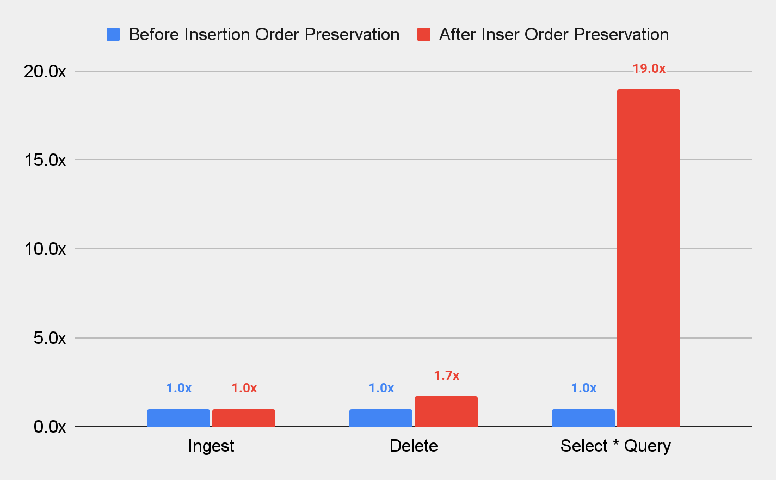



Natural sort order preservation
EFFICIENT DATA SKIPPING
Out of the box data skipping with no partitioning or z-order required
Preserves natural clustering across all Delta operations (DML, ingestion, maintenance)
19x better query performance out of the box
Higher is better
000.csv
001.csv
997.csv
998.csv
999.csv
T + 5
T + 3
T + 0
T + 1
Setup: Store Sales table with data naturally ordered by date
(51% of tables are queried by time)
Notes:
Add animation to first talk about How and then IMpact
DELETES are now up to 40% faster
READ query up to 95% faster
No partitioning needed!
AWS
Maintenance Operations + DML w/o Subqueries GA
DML Subquery Support - July 2022
Azure
Maintenance Operations + DML w/o Subqueries GA
DML Subquery Support - July 2022
GCP
Maintenance Operations + DML w/o Subqueries GA
DML Subquery Support - July 2022

Slide 81
Example of sort preservation
keys, payload, 1
keys, payload, 1
keys, payload, 2
keys, payload, 1
keys, payload, 2
keys, payload, 3
keys, payload, 2
keys, payload, 2
keys, payload, 3
keys, payload, 4
keys, payload, 5
keys, payload, 4
keys, payload, 1
keys, payload, 1
keys, payload, 2
keys, payload, 1
file-1
Min 1
Max 2
file-2
Min 2
Max 3
keys, payload, 2
keys, payload, 3
keys, payload, 2
keys, payload, 2
Each file is already pseudo clustered time, and files are tagged with ingestion time
file-3
Min 3
Max 5
keys, payload, 3
keys, payload, 4
keys, payload, 5
keys, payload, 4
Tags":{ "INSERTION_TIME":"1705524318000002", "MIN_INSERTION_TIME":"1705524318000002", "MAX_INSERTION_TIME":"1705524318000002"}
Time

Slide 82
Example of sort preservation
keys, payload, 1
keys, payload, 1
keys, payload, 2
keys, payload, 1
keys, payload, 2
keys, payload, 3
keys, payload, 2
keys, payload, 2
keys, payload, 3
keys, payload, 4
keys, payload, 5
keys, payload, 4
keys, payload, 1
keys, payload, 1
keys, payload, 2
keys, payload, 1
keys, payload, 2
keys, payload, 3
keys, payload, 2
keys, payload, 3
keys, payload, 4
keys, payload, 5
keys, payload, 4
keys, payload, 5
keys, payload, 5
keys, payload, 7
keys, payload, 8
1.parquet
Min 1
Max 2
1.parquet
Min 1
Max 2
1.parquet
Min 2
Max 3
2.parquet
Min 2
Max 3
Merge
keys, payload, 5
keys, payload, 5
keys, payload, 7
keys, payload, 8
3.parquet
Min 3
Max 5
3.parquet
Min 3
Max 5
4.parquet
Min 5
Max 8
Even though we updated or deleted a record, the order is still the same

Slide 83
Minimize DML Impact to existing ordering
Low Shuffle Merge
Output
keys, payload, 1
keys, payload, 1
keys, payload, 2
keys, payload, 1
keys, payload, 2
keys, payload, 3
keys, payload, 2
keys, payload, 3
keys, payload, 4
keys, payload, 5
keys, payload, 4
keys, payload, 5
keys, payload, 5
keys, payload, 7
keys, payload, 8
1.parquet
Min 1
Max 2
Scan source
Scan target
Scan target (matching rows only)
Scan source
2.parquet
Min 2
Max 3
Inner Join
Right outer join
(only shuffle new data)
3.parquet
Min 3
Max 5
Matching target files
Apply Changes
4.parquet
Min 5
Max 8
Write Data
(excluding unmodified rows)
Scan target (unmatching rows in matching files only)
Write unmodified data, removing updates and deletes

Slide 84
Deletion Vectors
No more write amplification
Deletion vectors remove the need to rewrite entire files for updates and deletes, which is often where most of the time in the merge is
Delete row 4
Update row 4
Insert data
File
DV
File
DV
File
rowNum, data
1, data
2, data
3, data
4, data
5, data
6, data
7, data
8, data
0
0
0
1
0
0
0
0
rowNum, data
1, data
2, data
3, data
4, data
5, data
6, data
7, data
8, data
0
0
0
1
0
0
0
0
rowNum, data
1, data
2, data
3, data
4, data
5, data
6, data
7, data
8, data
rowNum, data
1, data
rowNum, data
1, data

Slide 85
Lifecycle of Predictive I/O for Updates
Predictive I/O intelligently optimizes both read and writes
Step 1 → DML Command
Step 2 → Read File
DELETE
Predictive I/O
SELECT
FILTER
FILE 001 - DV 001
File 001
File 001
DV 001
DV
001
Step 3 → DML on File w/Deleted Rows
Maintenance Step → OPTIMIZE on File w/Deletes
DELETE
Predictive I/O
OPTIMIZE
File 001
File 002
File 001
File 002
DV 001
Rewrite
DV 001
Rewrite
Notes:
Let’s look at what happens with Predictive I/O for Updates when a DML command is run.
Initially on a DML command, Predictive I/O uses its intelligence to analyze the query and determine whether a Deletion Vector should be applied or not. Let’s say in this case, it does.
Once applied, Delta automatically determines when tables contain Deletion Vectors and returns the correct table representation by filtering out the deleted rows from the file.
Now let’s look at the scenario where a DML command is run on a file that already contains deleted rows. Depending on the DML command, Predictive I/O optimizes for both read and write performance, instructing auto-compaction to compact out Deletion Vectors and rewrite the file when necessary.
In addition to write-time compaction, OPTIMIZE will also compact out any deleted rows if it is already compacting the file as it is going to rewrite the file anyway.

Slide 86
Native Support for Object Storage Tiers
Minimizing the cost of storage
base/path/my_table/
_delta_log/
_last_checkpoint
00009.json
00010.json
00010.checkpoint.parquet
00011.json
date=2022-09-01/
datafile1.snappy.parquet
datafile2.snappy.parquet
datafile3.snappy.parquet
date=2022-09-02/
datafile30.snappy.parquet
datafile80.snappy.parquet
datafile100.snappy.parquet
Archival support in Databricks introduces a collection of capabilities that enable users to use cloud-based lifecycle policies on cloud object storage using Delta Lake tables
Intelligent Tiering
Glacier

Slide 87
How Does Delta Change Data Feed Work?
Original Table (v1)
Change data
(Merged as v2)
Change Data Feed Output
PK | B | Change Type | Time | Version
A2 | B2 | Preimage | 12:00:00 | 2
A2 | Z2 | Postimage | 12:00:00 | 2
A3 | B3 | Delete | 12:00:00 | 2
A4 | B4 | Insert | 12:00:00 | 2
 | PK | B
 | A1 | B1
 | A2 | B2
 | A3 | B3
 | PK | B
 | A2 | Z2
 | A3 | B3
 | A4 | B4
A1 record did not receive an update or delete.
So it will not be output by CDF.

Slide 88
Generated Columns
A generated column is a special column that’s defined with a SQL Expression
create table events ( eventId bigint, eventTime timestamp, Date date GENERATED ALWAYS AS (cast(eventTime AS DATE)) Partitioned by (date)

Slide 89
Generated Columns
Querying a generated column will apply partition pushdown if you use the generated column, or the column it was generated from
SELECT * From events WHERE eventTime >= "2020-10-01 00:00:00" <= "2020-10-01 12:00:00"
For the above query, we will generate a partition filter and only read the date 2020-10-01

Slide 90
Support for Identity Columns, Primary + Foreign Key Constraints
IDENTITY COLUMNS
PRIMARY + FOREIGN KEY DECLARATIONS
Define IDENTITY column on a table
Delta can automatically generate unique integer values when new rows are added to the table with IDENTITY columns
Users can also explicitly insert values for the IDENTITY columns
Declare unenforced Primary and Foreign keys with ALTER TABLE
Visible in INFORMATION_SCHEMA and DESCRIBE TABLE
Allow end users to understand relationships between tables
GOAL: Enable data quality and easy table relationship discovery for tools and users that are not familiar with the data model.

Slide 91
Generating Identity Columns
Delta Lake Identity Support
CREATE TABLE IF NOT EXISTS dim_loan
(
Loan_sk BIGINT GENERATED ALWAYS AS IDENTITY,
Loan_id BIGINT,
……..
)
USING DELTA
LOCATION 'abfs://<container>@<storage account>/'
Options
ALWAYS | BY DEFAULT
START WITH start
INCREMENT BY step
Generated columns only work when pre-creating table
Always option doesn’t allow column override
By Default option does allow column override but *doesn’t enforce duplicates*
Start With option allows you to start anywhere
Increment option allows you to set the increment
Modify settings with ALTER
1
Notes:
https://docs.microsoft.com/en-us/azure/databricks/spark/latest/spark-sql/language-manual/sql-ref-syntax-ddl-create-table-using

Slide 92
Semi-Structured Data
Complex and Evolving schemas are hard!
{ "name": "Chris", "age": 23, "address": { "city": "New York", "country": "America" }, "friends": [ { "name": "Emily", "hobbies": [ "biking", "music", "gaming" ] }, { "name": "John", "hobbies": [ "soccer", "gaming" ] } ] }
StructType([ StructField("name", StringType(), True), StructField("age", IntegerType(), True), StructField("address", MapType(StringType(),StringType()), True), StructField("friends", ArrayType( MapType(StringType(), ArrayType(StringType(),true),true)))
])

Slide 93
What is a VARIANT?
New Variant data type in Spark engine
Variant can represent semi-structured data, including arrays or structs
No fixed schema for Variant data
New binary encoding format for Variant data
Better memory/space efficiency than string type
Faster processing performance than string type
Extend familiar language constructs to query Variant data
Reuse many existing convenient expressions and syntax
Benchmarks show 4-20x performance improvement

Slide 94
Usage examples
-- Create a Variant column
CREATE TABLE T (variant_col Variant)
-- Use PARSE_JSON() to parse JSON string to Variant
INSERT INTO T (variant_col)
SELECT PARSE_JSON(json_str_col) FROM other_table
-- Path navigation
SELECT variant_col:a.b.c::int, variant_col:arr[1].field::double FROM T
-- Flatten objects
SELECT key, value FROM T, LATERAL explode(T.variant_col:obj)

Slide 95
Predictive Optimization
Goal AI model determines which tables to do which maintenance operations, at what time
Inputs
Table usage patterns
Table performance
Table file sizes and partitions
Table history
ROI calculation
For each table and optimization, what is the expected benefit vs. the expected cost
Output
Optimal schedule of table optimizations - prioritizing highest ROI tables

Slide 96

Predictive Optimization
A Toy Example…
Determine OPTIMIZE return-on-investment
Table | Query speedup | OPTIMIZE cost | Table usage | Expected ROI
1 | HIGH | LOW | LOW | LOW
2 | HIGH | LOW | HIGH | HIGH
3 | LOW | LOW | HIGH | LOW
4 | HIGH | HIGH | HIGH | MEDIUM
Inputs
Table usage patterns
Table performance
Table file sizes and partitions
Table history
Notes:
From there, we can calculate an expected return on investment for OPTIMIZE for each table, weighing the costs with the benefits
By doing this, we can avoid some common gotcha’s
For table #1, the table is expected to get much faster with very little work, but also no one is querying it, so we say the expected ROI is low
For table #3 - a lot of people use it, but we don’t expect to get much out of optimizations so also the ROI is low

Slide 97
Predictive Optimization
A Toy Example…
Determine VACUUM return-on-investment
Table | VACUUMable data | VACUUM cost
1 | HIGH | LOW
2 | LOW | LOW
3 | HIGH | HIGH
4 | LOW | HIGH
. . .
Inputs
Table usage patterns
Table performance
Table file sizes and partitions
Table history
Notes:
We can then repeat this same thing for other optimizations, like VACUUM
For those of you don’t know, vacuum eliminates unneeded files, which have already been deleted and have fallen out of your data retention period
Here note that the considerations are way different - now, we no longer care how often the table is being used, since the goal is just to delete unneeded data to save storage cost
Here we’re concerned about how much data we could delete, and what the cost would be to do so
So we won’t go through the whole flow again, but you can imagine this process repeated for each optimization we run

Slide 98
UniForm

Slide 99
















Choosing a data lake format?
Apache Hudi
Delta Lake
Apache Iceberg
Metadata
Used for transactional source of truth, concurrency control, etc.
Metadata
Metadata
Metadata
Parquet
Parquet
Parquet
Data
All formats use Parquet!
Connector Ecosystem
Microsoft
Fabric
Notes:
Previously you had to choose between these table storage formats that largely serve the same purpose – each with different protocols and features, each with different connector ecosystems

Slide 100
Delta UniForm
Write Delta, read as Iceberg
Delta Lake
With UniForm
Metadata
Used for transactional source of truth, concurrency control, etc.
Metadata
Parquet
Data
All formats use Parquet!
Connector Ecosystem
Microsoft
Fabric
Notes:
Solution: With Delta UniForm, customer don’t have choose between table storage format
Customer can write Delta and access as Iceberg or Hudi downstream
Key Benefits:
One copy of the data
Metadata is co-located with data
Metadata automatically generated to make Delta accessible as Iceberg/Hudi
Can access the combined ecosystem

Slide 101
How Delta Lake UniForm works
Metadata automatically generated to make Delta accessible as Iceberg/Hudi
Parquet files remain the same
Metadata is co-located with data
Delta Lake UniForm
Data stored in Delta can be read as if it were Iceberg or Hudi
Notes:
UniForm is incredibly easy to use. Once enabled, UniForm:
Automatically generates Iceberg or Hudi metadata alongside Delta Lake
The Parquet files remain the same – there is no duplication of data
Metadata is co-located with the data – the metadata for all enabled formats is accessible to any engine in your own storage bucket

Slide 102

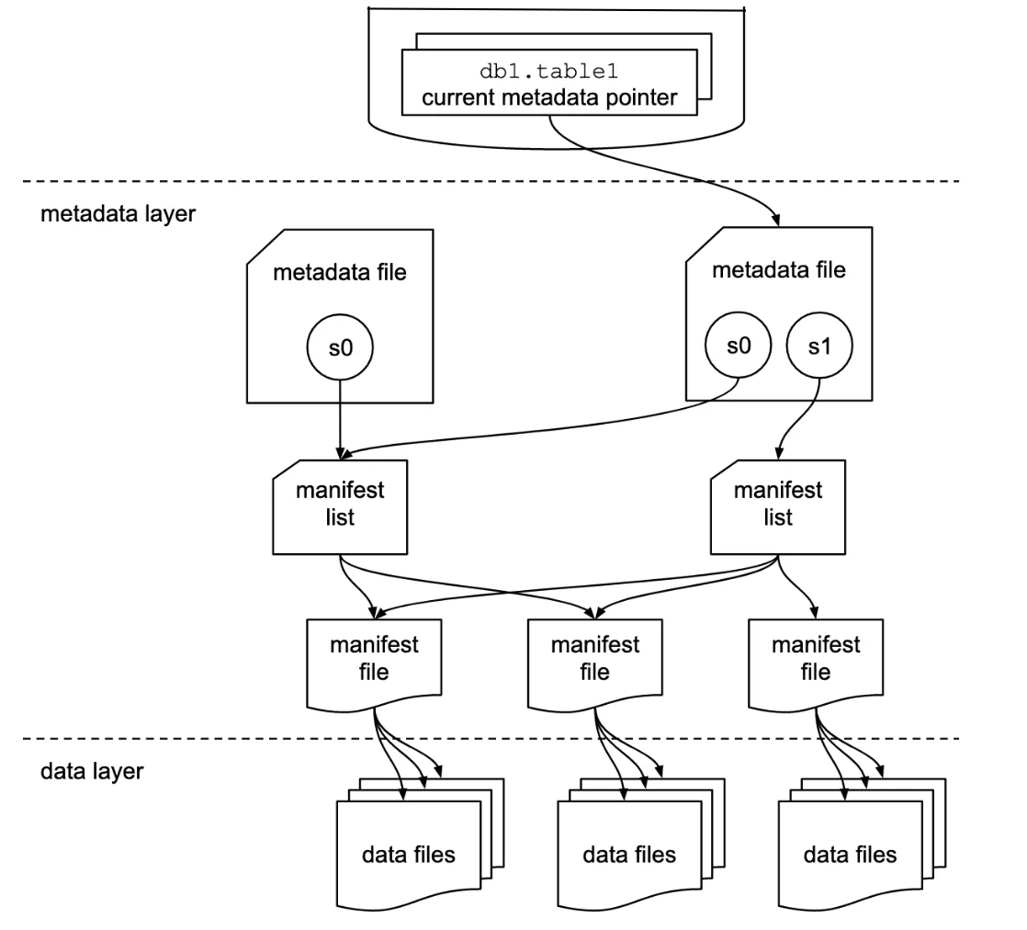
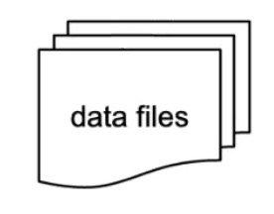
db1.table1
_delta_log
000.checkpoint
001.json
002.json
data layer
Notes:
The key behind UniForm is that the metadata for Delta can be easily and cheaply converted to Iceberg metadata
At first, if you look at the two metadata formats, they may seem different at first
For example, in Delta: as we’ve seen each commit file is incremental - it’s a delta from the previous update.
Whereas in Iceberg, each commitis self-contained - it includes all the relevant information about the table at that given point in time

Slide 103
AddFile
DataFile
path
partitionValues
size
stats.numRecords
stats.minValues
stats.maxValues
stats.nullCount
file_path
partition
file_size_in_bytes
record_count
lower_bounds
upper_bounds
null_value_counts
Notes:
But if you look even more closely, it turns out that the metadata for Delta Lake and Iceberg are very similar
If you look at an add file action in Delta, and compare with the equivalent action in DataFile, you’ll see they they contains the same exact information
Including the path of the updated file
The partition information
The size of the file
Data skipping stats, etc.
And UniForm uses this principle to very quickly and cheaply take Delta metadata and generate the corresponding Iceberg metadata

Slide 104




Observation: Very similar writes on both sides
INSERT INTO
1) Writes and commits
SELECT
Catalog
2) Notify catalog of commits
Delta writer
Delta reader
1) Writes data and metadata
INSERT INTO
2) Commits to catalog
Catalog
SELECT
Iceberg writer
Iceberg reader
Notes:
And not only are the metadata formats similar between Delta and Iceberg, but the overall flow is similar as well
For both formats, writes result in commits which write both metadata and data

Slide 105
Observation: Very similar writes on both sides
INSERT INTO
1) Writes and commits
SELECT
Catalog
2) Notify catalog of commits
Delta writer
Delta reader
1) Writes data and metadata
INSERT INTO
2) Commits to catalog
Catalog
SELECT
Iceberg writer
Iceberg reader
Notes:
And in both cases, the writes can push metadata to a catalog
And to read the table, readers can go to the catalog in order to get the latest metadata, which then points to the data

Slide 106


UniForm concept unifies the write path
INSERT INTO
1) Writes and commits
SELECT
Catalog
2) Notify catalog of commits
Delta writer
Delta reader
SELECT
Iceberg reader
Notes:
And so with UniForm, you simply combine those steps into a single flow, avoiding the mostly duplicated work
A write to Delta Lake generates commits and metadata for both Iceberg and Delta
And then we push the information to the catalog
Which then both Delta and Iceberg readers can query

Slide 107
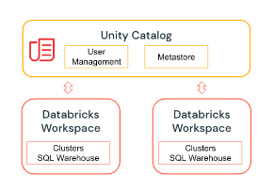
UniForm as implemented by Databricks
INSERT INTO
1) Writes and commits
SELECT
Unity
Catalog
2) Notify catalog of commits
Delta writer
Delta reader
Iceberg
REST API
SELECT
Iceberg reader
Notes:
And in particular, in Databricks, Unity Catalog exposes the Iceberg REST Catalog API
Which many Iceberg readers can access to in order to seamlessly read the Iceberg

Slide 108
v0
v1
v2
v3
Iceberg v1
Iceberg v2
Notes:
Delta commits continue as fast as is (same as scenario without UniForm)
Delta commits are really fast and we automatically batch multiple Delta commits in Iceberg

Slide 109
v0
v1
v2
v3
Universal Format
v0
v1
v2
v3
Iceberg v1 (Delta v0)
Iceberg v2 (Delta v1, v2, v3)
Iceberg v1
Iceberg v2
Notes:
Delta commits continue as fast as is (same as scenario without UniForm)
Delta commits are really fast and we automatically batch multiple Delta commits in Iceberg

Slide 110
POP QUIZ
Notes:
UniForm is incredibly easy to use. Once enabled, UniForm:
Automatically generates Iceberg or Hudi metadata alongside Delta Lake
The Parquet files remain the same – there is no duplication of data
Metadata is co-located with the data – the metadata for all enabled formats is accessible to any engine in your own storage bucket

Slide 111
POP QUIZ
Notes:
UniForm is incredibly easy to use. Once enabled, UniForm:
Automatically generates Iceberg or Hudi metadata alongside Delta Lake
The Parquet files remain the same – there is no duplication of data
Metadata is co-located with the data – the metadata for all enabled formats is accessible to any engine in your own storage bucket

Slide 112
Use Cases

Slide 113

Challenge Provide 182 million wireless customers with secure, reliable and frictionless communications.
10M+ transactions per second
How to stay ahead of fraudsters - e.g., robocalls, texts, identity theft
Use data and AI to stop attacks before they happen.
On-prem infrastructure struggling to keep up
Industry:
Communication service
providers
Use case:
Threat detection
Notes:
https://www.databricks.com/customers/att

Slide 114
Solution
“We’re able to ingest huge amounts of structured and unstructured data coming from different systems, standardize it, and then build ML models that deliver alerts and recommendations that empower employees in our call centers, stores, and online.”
Kate Hopkins VP, AT&T
Industry:
Communication service
providers
Use case:
Threat detection
Notes:
https://www.databricks.com/customers/att

Slide 115
Outcome
80% decrease in fraud attacks
Thanks to 100+ ML models in production
Millions saved
in potential costs
Industry:
Communication service
providers
Use case:
Threat detection
Notes:
https://www.databricks.com/customers/att

Slide 116

Challenge Leverage data across their business lines to impact sales, purchasing, supply chain, and product optimization
“Our legacy systems could take weeks to ETL data for analytics and reporting. As a result, we were unable to support a variety of use cases, impacting analyst and line-of-business satisfaction.”
Lara Minor Senior enterprise data manager
Industry:
Retail
Use cases
Advertising effectiveness,
customer segmentation,
product matching,
recommendation engines
Notes:
https://www.databricks.com/customers/columbia
Columbia Sportswear, like most companies, wanted to use data across their lines of business
Sales, purchasing, supply chain, product optimization, you name it
They saw that their legacy system were taking weeks to ETL data
As you can imagine, this was an extremely strong headwind towards being a data and AI company

Slide 117
Solution
With Databricks, build high-performance ETL pipelines that support batch and real-time workloads.
The pipelines feed into Delta Lake which provides secure access to curated data
“Delta Lake provides ACID capabilities that simplify data pipeline operations to increase pipeline reliability and data consistency. At the same time, features like caching and auto-indexing enable efficient and performant access to the data.”
Lara Minor Senior enterprise data manager
Industry:
Retail
Use cases
Advertising effectiveness,
customer segmentation,
product matching,
recommendation engines
Notes:
The solution: with Databricks and Delta Lake, they were able to build a super high performance ETL pipeline
They saw that Delta’s ACID capabilities significantly simplified their operations
And also they saw significantly more performant access to their data

Slide 118
Outcome
70% reduction in ETL pipeline creation time
48x improvement in time to process ETL workloads (4 hours to 5 minutes)
“One of the benefits of this platform is how fast people can come up to speed on it. All that data is coming in, and more business units are using it across the enterprise in a self-service manner that was not possible before.”
Lara Minor Senior enterprise data manager
Industry:
Retail
Use cases
Advertising effectiveness,
customer segmentation,
product matching,
recommendation engines
Notes:
https://www.databricks.com/customers/columbia
The outcome was a 70% reduction in ETL pipeline creation time
A 48x improvement in the time to process ETL workloads - from 4 hours to 5 minutes
The impact was felt across the organization, empowering business units to self serve data in a way they never could before

Slide 119

Challenge Creating the most efficient transportation network in North America
Unlock value of data stuck in legacy DW systems
Massive data volumes from data streams from IoT sensors
Legacy systems struggled to scale
This made telemetry-based use cases leveraging machine learning (ML) and AI nearly impossible.
Industry:
Manufacturing and Logistics
Use cases
Demand forecasting
Notes:
https://www.databricks.com/customers/jbhunt
JB Hunt is a logistics and transportation company, whose goal is to create the most efficient transportation network in North America
Their systems struggled to take in a massive volume of IoT data, hitting scale problems
Not only that, but they struggled to incorporate and join their IoT data against data in their legacy DW systems
Their goal was to leverage ML and AI against this data
But the struggles above really made this impossible

Slide 120
Solution
Create an open, interoperable and rapid data lakehouse.
Delta Lake as the open storage layer brought efficiency and portability at TB-scale
Stream data real-time to Delta Lake - high performance and reliability at any scale
Single copy of data for easier analysis and reproducibility
Build ML models atop single source of truth data
Industry:
Manufacturing and Logistics
Use cases
Demand forecasting
Notes:
The solution was to create an open, interoperable data lakehouse
By using Delta Lake as the open storage layer, tehy were able to achieve efficiency and portability at scale
Not only were they able to stream their IOT data real-time to data lake
But also join it against data elsewhere in their lake
This resulted in a single copy of data for easier analysis, reproducibility and ML analysis

Slide 121
Outcome
99.8% Faster freight recommendations
$2.7M in IT infrastructure savings
Industry:
Manufacturing and Logistics
Use cases
Demand forecasting
Notes:
https://www.databricks.com/customers/jbhunt

Slide 122
Replicating application data to the Lakehouse
Notes:
One key spotlight use case is replicating application data to your lakehouse
For example, you might have data in an external database like MySQL that you want in your lakehouse for analytics, ML, etc.

Slide 123

Current Challenges
Identifying Changes
Updates in ETL struggle to find changes in the data from version to version in large tables
Without information regarding the specific changes to be made, all data must be compared
Notes:
As your data is incrementally updated in the application database, you want to identify and apply those changes to your lakehouse tables

Slide 124


Current Challenges
Identifying Changes
Updating BI & Analytics Data
Updates in ETL struggle to find changes in the data from version to version in large tables
Without information regarding the specific changes to be made, all data must be compared
Real-time updates to BI and analytics require additional processing as changes arrive
Recalculating full datasets causes downtime to users incompatible with real-time needs
Audits of records, en masse or individually, demand the ability to readily construct data as it was at any or every point in time
Digging through all versions is impractical yet required to meet compliance requirements
Notes:
And you don’t want to recalculate the entire table, since your end users might rely on these tables for latency-sensitive use cases
E.g., real time dashboards

Slide 125
Current Challenges
Identifying Changes
Updating BI & Analytics Data
Producing an Audit Trail
Updates in ETL struggle to find changes in the data from version to version in large tables
Without information regarding the specific changes to be made, all data must be compared
Real-time updates to BI and analytics require additional processing as changes arrive
Recalculating full datasets causes downtime to users incompatible with real-time needs
Audits of records, en masse or individually, demand the ability to readily construct data as it was at any or every point in time
Digging through all versions is impractical yet required to meet compliance requirements
Notes:
And finally, you might want an audit of records and changes for compliance requirements

Slide 126




Centralizing all your data shouldn’t be hard
One of the most common use cases
Extract cdc
External tool
…
External database
users
transactions
products
items
…
raw cdc files
Sent on blob storage or message queue
Notes:
Here’s a typical reference architecture for a use case like this
You have your external database, from which you can get change data capture files in your data lake

Slide 127


Use autoloader to incrementally ingest your raw data into Delta Lake
spark.readStream .format("cloudFiles") .option("cloudFiles.format", "json") .load("/raw_cdc_files") .writeStream .trigger(availableNow=True) .toTable("raw_cdc"))
Auto Loader
Incrementally load new data
Extract cdc
External tool
…
External database
users
transactions
products
items
…
raw cdc files
Sent on blob storage or message queue
raw_cdc
Full cdc history
Notes:
From there, you can use autoloader to ingest that into a bronze level table
This is a Delta table version of the raw change data capture

Slide 128

Use Structured Streaming to incrementally clean records from bronze to silver
spark.readStream .format("delta") .table("raw_cdc") .transform(...) .writeStream
.foreachBatch(mergeIntoSilver) .trigger(availableNow=True) .start()
Auto Loader
Incrementally load new data
Clean records
Using structured streaming
Extract cdc
External tool
…
External database
users
transactions
products
items
…
raw cdc files
Sent on blob storage or message queue
raw_cdc
Full cdc history
app_silver
Materialize client table, data available in SQL
Notes:
From there, you may need to clean the change data feed a bit for before it lands in your gold table
So you might use a structured stream to process and clean the bronze files into the silver layer

Slide 129
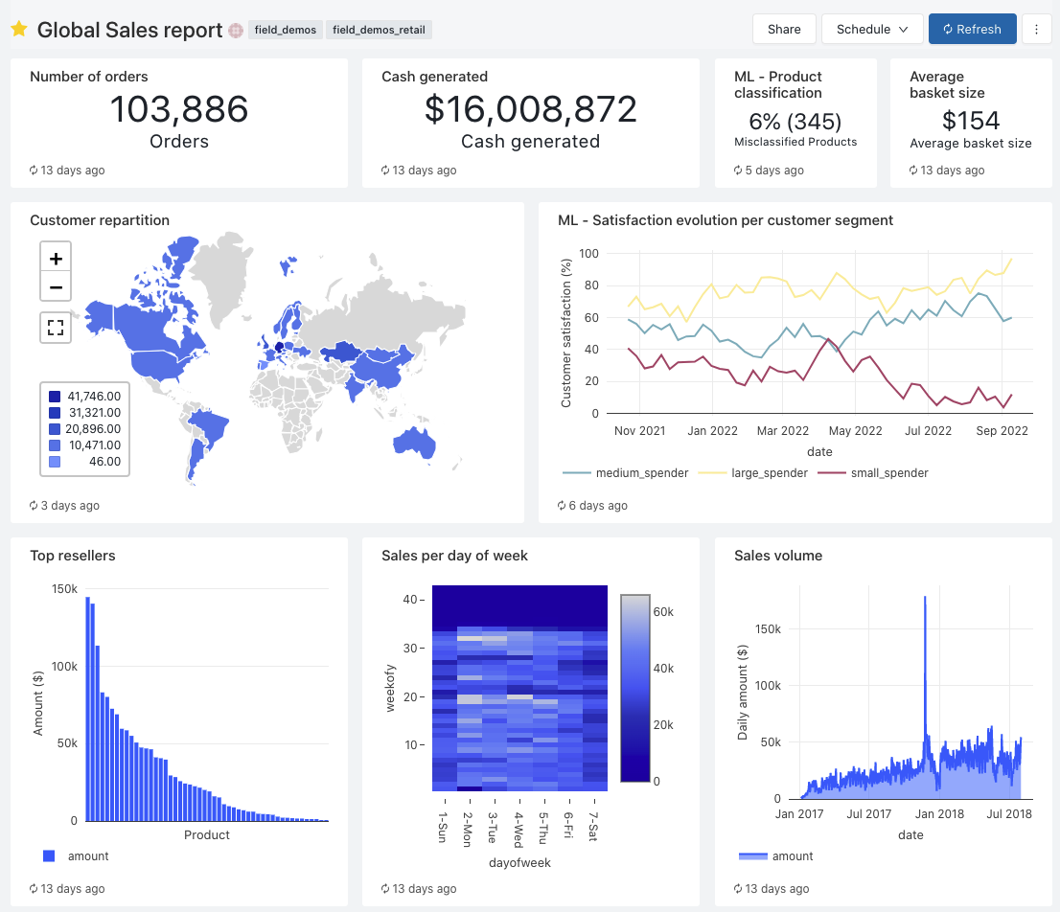

MERGE into Gold Table
One of the most common use cases
delta.enableChangeDataFeed = true
Auto Loader
Incrementally load new data
Delta SQL Merge
Merge based on client ID
Delta CDC + Merge
Propagate updates downstream
Extract cdc
External tool
…
External database
users
transactions
products
items
…
raw cdc files
Sent on blob storage or message queue
raw_cdc
Full cdc history
app_silver
Materialize client table, data available in SQL
app_gold
Clean data ready for
ML / Dashboards
Notes:
And from there, you can use change data feed and MERGE commands to create the final gold table, which represents the state of the external database. The beauty with this end to end architecture is that you’re fully incrementally processing the data - ensuring that you’re up to date the latest version with minimal latency.

Slide 130
Incremental processing with Delta Lake
Read the change data feed to propagate changes down stream
Leverage Merge to minimize write amplification
spark.readStream .format("delta") .option("readChangeFeed", "true") .table("app_silver") .agg(...) .writeStream .foreachBatch(mergeIntoGold) .trigger(availableNow=True) .start()
def mergeIntoGold(batch: DataFrame, batchId: Long) { batch.createOrReplaceTempView("updates") batch.sparkSession.sql(s"""
MERGE INTO app_gold t USING updates s ON s.key = t.key WHEN MATCHED THEN UPDATE SET * WHEN NOT MATCHED THEN INSERT *
""") }

Slide 131
Developing AI/ML models with Delta Lake

Slide 132
Reproducibility for AI/ML development
Good ML starts with high-quality data.
Model reproducibility starts with data reproducibility
Many factors affect the outcome of a model
Adding new data sets
Data distribution
Sample changes

Slide 133
Delta Lake makes model reproducibility easy
Use cases: model retraining, comparison of different model versions, debugging
Dataset versioning
Automatic versioning for every change (insert, delete, update)
Change tracking
Maintain a detailed log of all data modifications, facilitates audits and lineage
Full history and rollback
Rollback to previous versions of the dataset as needed

Slide 134
Step 1: Initial model training
# Initialize Spark session
spark = SparkSession.builder.appName("DeltaLakeExample").getOrCreate()
# Load version 1 of the dataset
df_v1 = spark.read.format("delta").option("versionAsOf", 1).load("/path/to/delta-table")
# Preprocess data
assembler = VectorAssembler(inputCols=["feature1", "feature2"], outputCol="features")
data_v1 = assembler.transform(df_v1)
# Train initial model
lr = LinearRegression(featuresCol="features", labelCol="label")
model_v1 = lr.fit(data_v1)
# Save the model
model_v1.save("/path/to/save/model_v1")
Notes:
Scenario: Retraining a model with new data
Steps:
Train initial model on version 1 of the dataset
New data is added, creating version 2 of the dataset
Retrain the model using version 2 and compare performance
Rollback to version 1 if needed to debug issues or compare results

Slide 135
Step 2: Adding new data
# Load new data
new_data = spark.read.format("csv").option("header", "true").load("/path/to/new-data.csv")
# Merge new data into the Delta table
new_data.write.format("delta").mode("append").save("/path/to/delta-table")
Notes:
Scenario: Retraining a model with new data
Steps:
Train initial model on version 1 of the dataset
New data is added, creating version 2 of the dataset
Retrain the model using version 2 and compare performance
Rollback to version 1 if needed to debug issues or compare results

Slide 136
Step 3: Retraining the model
# Load version 2 of the dataset
df_v2 = spark.read.format("delta").option("versionAsOf", 2).load("/path/to/delta-table")
# Preprocess data
data_v2 = assembler.transform(df_v2)
# Retrain model
model_v2 = lr.fit(data_v2)
# Save the new model
model_v2.save("/path/to/save/model_v2")
# Compare model performance
predictions_v1 = model_v1.transform(data_v2)
predictions_v2 = model_v2.transform(data_v2)
Notes:
As such, this enables time travel based on data versions so you can keep the data constant while making changes to the model, hyperparameters, etc.
However, you’re not locked in to a given schema with Delta, as it supports schema evolution, so you’re able to add additional features as input to your machine learning models.

Slide 137
Step 3: Retraining the model
# Load version 2 of the dataset
df_v2 = spark.read.format("delta").option("versionAsOf", 2).load("/path/to/delta-table")
# Preprocess data
data_v2 = assembler.transform(df_v2)
# Retrain model
model_v2 = lr.fit(data_v2)
# Save the new model
model_v2.save("/path/to/save/model_v2")
# Compare model performance
predictions_v1 = model_v1.transform(data_v2)
predictions_v2 = model_v2.transform(data_v2)
📉🔥
Notes:
Uh oh performance got way worse

Slide 138
Step 4: Rollback and debugging
# Rollback to version 1 of the dataset
df_rollback = spark.read.format("delta").option("versionAsOf", 1).load("/path/to/delta-table")
# Compare version 1 and version 2 data
df_v2 = spark.read.format("delta").option("versionAsOf", 2).load("/path/to/delta-table")
df_rollback.show()
df_v2.show()
Notes:
Delta makes it easy to rollback and compare what happened between versions of datasets – perhaps sample or distribution drifted way off, significantly affecting your models performance
And history() means you can easily trace the lineage of all changes to the underlying data, ensuring that your model can be reproduced with exactly the same data it was built on. You can specify a specific version or timestamp when you load in your data from Delta Lake.

Slide 139
Step 4: Rollback and debugging
# Rollback to version 1 of the dataset
df_rollback = spark.read.format("delta").option("versionAsOf", 1).load("/path/to/delta-table")
# Compare version 1 and version 2 data
df_v2 = spark.read.format("delta").option("versionAsOf", 2).load("/path/to/delta-table")
df_rollback.show()
df_v2.show()
Rollback and history() make it easy to trace the lineage of all changes to the underlying data, ensuring that your model can be reproduced with exactly the same data it was built on.
Notes:
This makes it easy to trace the lineage of all changes to the underlying data, ensuring that your model can be reproduced with exactly the same data it was built on.
You can specify a specific version or timestamp when you load in your data from Delta Lake.

Slide 140
Feature innovation
Liquid Clustering
Better than partitioning, lower write amplification than Zorder, designed to pluggable with your own clustering algorithm
Column defaults
Allow default values when not specified in writes
Table Cloning
Quick shallow copy of table for experimentation
Merge improvements
WHEN NOT MATCHED BY SOURCE,idempotent MERGEs
table_changes()
Get row-level changes between 2 versions using SQL
Notes:
Speaker: Joe

Slide 141
Feature innovation: Under the hood
Table features
New, more flexible mechanism for adding Delta protocol changes and enabling/disabling them at will
Checkpoint V2, log compactions
More reliability and performance when dealing with tables having 100M+ files (that is, 10PB+)
Row ids
Unique identifiers for tracking each row
Deletion Vectors
Delta's "merge-on-read" solution, designed for the best upsert performance without sacrificing read performance

Slide 142
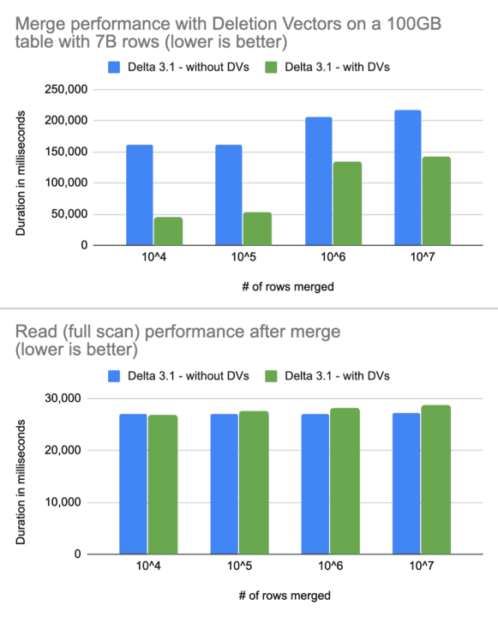
Out-of-the-box performance: DML
Deletion Vectors = Delete/Update/Merge on steroids!
upto 3.7x faster merges, with no loss of read perf
(also, upto 10x faster updates and deletes)

Slide 143
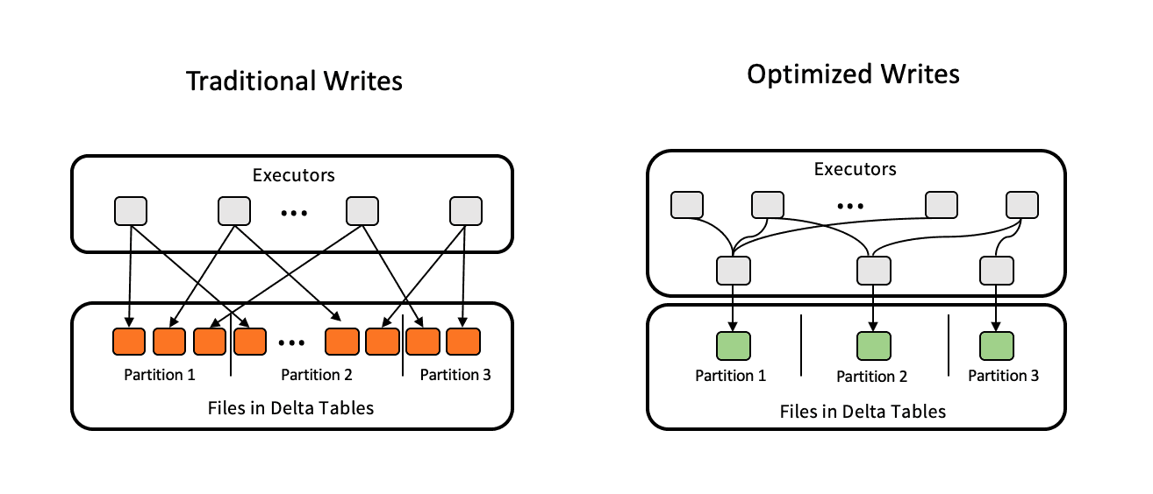
Out-of-the-box performance: reads
traditional writes
Optimized Write [Delta 3.1]
Each Spark write job rebalances data between tasks to generate larger files
Auto Compaction [Delta 3.1]
Each Spark write job does an additional mini-compaction of any existing small files; helps in real-time streaming jobs with lots of small writes
Together, they provides better read perf out-of-the-box even without Optimize
Optimized Writes

Slide 144
Roadmap

Slide 145
Roadmap
1
Simplified user experience
Data integrity and reliability
Seamless interoperability
2
3

Slide 146
Roadmap
1
Simplified user experience
Data integrity and reliability
Seamless interoperability
2
3

Slide 147
Simplified data management
Convert partitioned tables to Liquid without rewrite Upgrade tables in-place to Liquid
Notes:
Convert Partitioned Tables to Liquid without Rewrite: Enables effortless transition to more efficient Liquid clustering - without needing to rewrite your partitioned tables

Slide 148
Simplified data management
Convert partitioned tables to Liquid without rewrite Upgrade tables in-place to Liquid
Identity columns Easy button for primary and foreign keys
Notes:
Identity Columns: allow you to easily generate a unique ID for each row, a super common use case for creating primary and foreign keys

Slide 149
Simplified data management
Convert partitioned tables to Liquid without rewrite Upgrade tables in-place to Liquid
Identity columns Easy button for primary and foreign keys
Type widening Seamless, no-copy updates to wider data types (e.g., INT > LONG)
Notes:
Type Widening: as data expands, it’s common to wish that you’d started with a larger data type
for example, you might’ve started with INT but are no running into integer overflow issues.
With type widening, you can widen your types inline in your table seamlessly without data rewrites or workload interruption

Slide 150
Simplified data management
Convert partitioned tables to Liquid without rewrite Upgrade tables in-place to Liquid
Identity columns Easy button for primary and foreign keys
Type widening Seamless, no-copy updates to wider data types (e.g., INT > LONG)
VARIANT data type Highly flexible, highly performant data type for semi-structured data
Notes:
The VARIANT data type: allows you to easily work with semi-structured data like JSON -
it’s super flexible and much more performant than parsing as string, which has been the leading way to do this so far
We’re especially excited as semi-structured data use cases have exploded recently

Slide 151
Roadmap
1
Simplified user experience
Data integrity and reliability
Seamless interoperability
2
3

Slide 152
Data consistency and availability across multiple environments
Coordinated Commits Multi-cluster, multi-cloud writes
Notes:
Multi-cluster writes via coordinated commits coming soon. First commit owner implementation we are releasing is Dynamo DB. but can be any service or catalog. We are contributing HMS and Unity Catalog as commit owners

Slide 153
Data consistency and availability across multiple environments
Coordinated Commits Multi-cluster, multi-cloud writes
Built-in cross-region disaster recovery Ensure writes are accurately reflected in secondary region
Notes:
Cross-region disaster recovery - DR involves replicating to a secondary region. managed commits ensures committed data is accurately reflected in secondary region, no partial or inconsistent states.

Slide 154
Data consistency and availability across multiple environments
Coordinated Commits Multi-cluster, multi-cloud writes
Built-in cross-region disaster recovery Ensure writes are accurately reflected in secondary region
Collations Custom sorting and comparison rules
Notes:
Collations allow you set custom sorting and comparison rules for strings based on the appropriate for the language or cultural context - this is often crucial for applications that handle international data.

Slide 155
Data consistency and availability across multiple environments
Coordinated Commits Multi-cluster, multi-cloud writes
Built-in cross-region disaster recovery Ensure writes are accurately reflected in secondary region
Collations Custom sorting and comparison rules
Spark Connect support Improved debuggability, upgradability and reliability
Notes:
As you may have heard elsewhere, Spark Connect is a disruptive new architecture for Spark
This changes Spark to a client-server architecture, which will improve debuggability, upgradability and reliability for your Spark applications
Delta 4.0 will have full support for Spark Connect out of the box

Slide 156
Data consistency and availability across multiple environments
Coordinated Commits Multi-cluster, multi-cloud writes
Built-in cross-region disaster recovery Ensure writes are accurately reflected in secondary region
Collations Custom sorting and comparison rules
Spark Connect support Improved debuggability, upgradability and reliability
Multi-statement and Multi-table transactions Atomic transactions across tables
Notes:
And finally: multi-statement and multi-table transactions- as the name suggests, these let you to make atomic transactions across many transactions, even across tables.

Slide 157
Roadmap
1
Simplified user experience
Data integrity and reliability
Seamless interoperability
2
3

Slide 158
Seamless interoperability
Delta Kernel Integrate your client once, get the latest Delta innovations forever.
Notes:
With Delta Kernel, you can easily integrate any client with the latest-and-greatest Delta capabilities.
Delta Kernel will ensure that the Delta ecosystem stays up-to-date with the latest Delta innovations - like Deletion Vectors and Liquid clustering.

Slide 159
Seamless interoperability
Delta Kernel Integrate your client once, get the latest Delta innovations forever.
Expanding connector ecosystem Collaborating with community and partners to build connectors with Kernel

Slide 160
Seamless interoperability
Delta Kernel Integrate your client once, get the latest Delta innovations forever.
Expanding connector ecosystem Collaborating with community and partners to build connectors with Kernel
Delta UniForm Improved interoperability with latest Delta capabilities - e.g., Deletion Vectors
Notes:
And with Delta UniForm, we’re going to be continuously making improvements to achieve improved operability with all the open lakehouse formats
This includes upcoming support for more Delta capabilities, such as Deletion Vectors.
And we’ll continue working with the Hudi and Iceberg communities towards this exciting goal

Slide 161
POP QUIZ
Notes:
UniForm is incredibly easy to use. Once enabled, UniForm:
Automatically generates Iceberg or Hudi metadata alongside Delta Lake
The Parquet files remain the same – there is no duplication of data
Metadata is co-located with the data – the metadata for all enabled formats is accessible to any engine in your own storage bucket

Slide 162




Learn more at the summit!
Databricks Events App
Tells us what you think
What to do next?
Get trained and certified
We kindly request your valuable feedback on this session.
Please take a moment to rate and share your thoughts about it.
You can conveniently provide your feedback and rating through the Mobile App.
Discover more related sessions in the mobile app!
Visit the Demo Booth: Experience innovation firsthand!
More Activities: Engage and connect further at the Databricks Zone!
Visit the Learning Hub Experience at Moscone West, 2nd Floor!
Take complimentary certification at the event; come by the Certified Lounge
Visit our Databricks Learning website for more training, courses and workshops! databricks.com/learn

